Slide 1
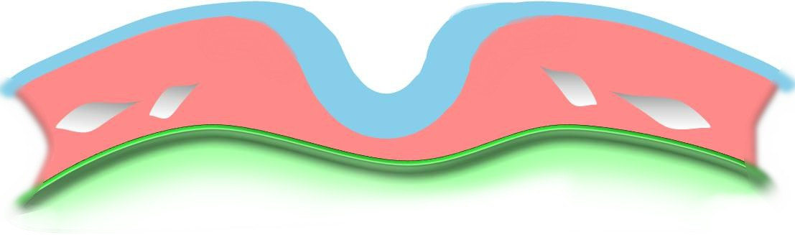
Heart - Early Folding
Trilaminar Embryo
Week 3, cardiac tube and surrounding cavity formation
UNSW Embryology

Slide 2
Ectoderm
Neural fold
Endoderm of yolk sac
Splitting of the lateral plate mesoderm forms the pericardial coelom

Slide 3
Ectoderm
Lateral plate mesoderm
Neural fold
Pericardial coelom forming
Endoderm of yolk sac
Splitting of the lateral plate mesoderm forms the intraembryonic coelom

Slide 4
Lateral plate mesoderm
Pericardial coelom forming
Splitting of the lateral plate mesoderm begins cranially and extends caudally throughout the embryo

Slide 5
Splitting of the lateral plate mesoderm begins cranially and extends caudally throughout the embryo

Slide 6
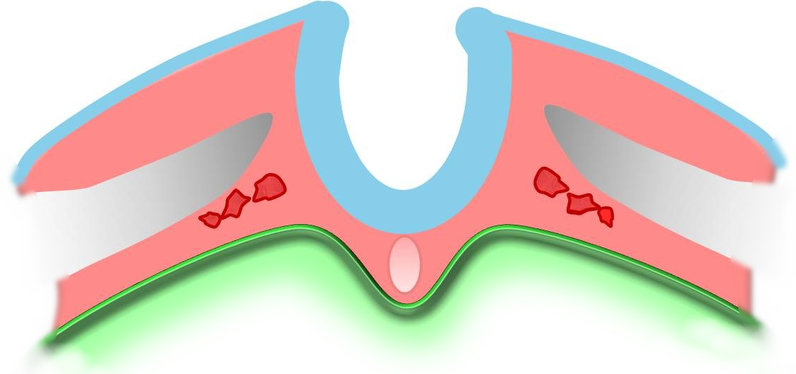
Splitting of the lateral plate mesoderm begins cranially and extends caudally throughout the embryo

Slide 7
Splitting of the lateral plate mesoderm forms the pericardial coelom
Somatic mesoderm
Pericardial coelom
Splanchnic mesoderm
Splitting of the lateral plate mesoderm forms pericardial coelom

Slide 8
Somatic mesoderm
Pericardial coelom
Angioblastic cord
Splanchnic mesoderm

Slide 10
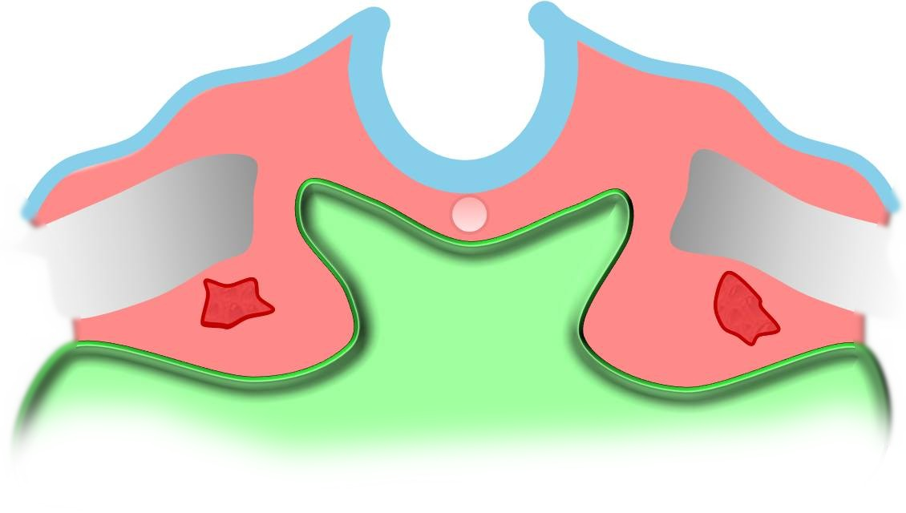

Slide 11
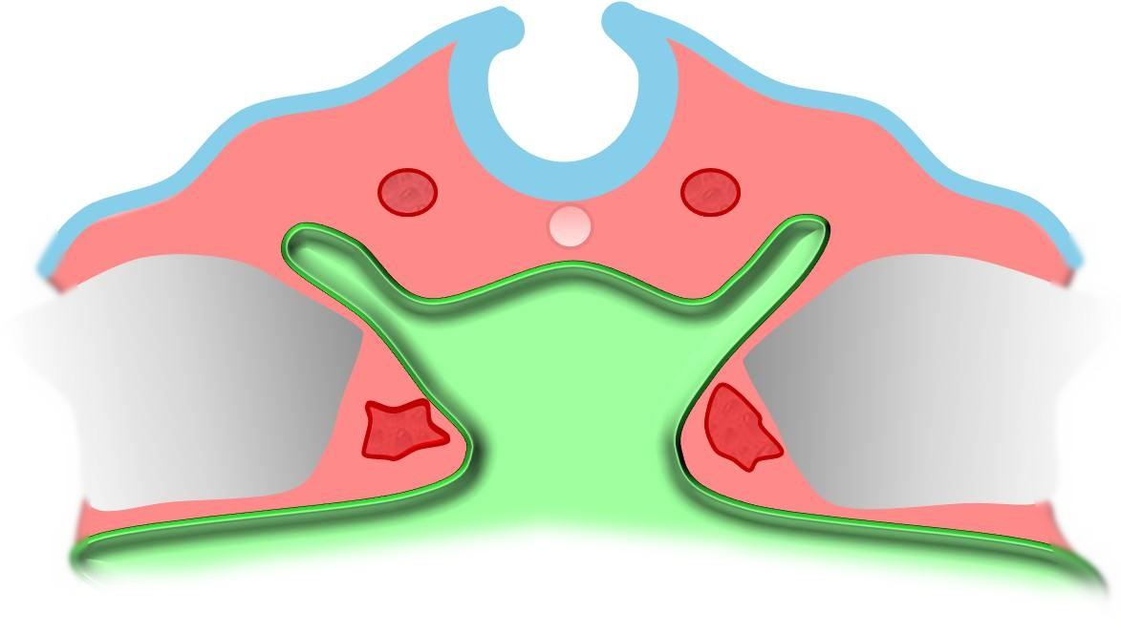

Slide 12
Dorsal aortae
Foregut forming

Slide 13
Dorsal aortae
Foregut forming
Endocardial heart tubes

Slide 14
Dorsal aortae
Foregut forming
Paired dorsal aorta form behind the endocardial tubes and connect prior to endocardial tube fusion
Endocardial heart tubes

Slide 16
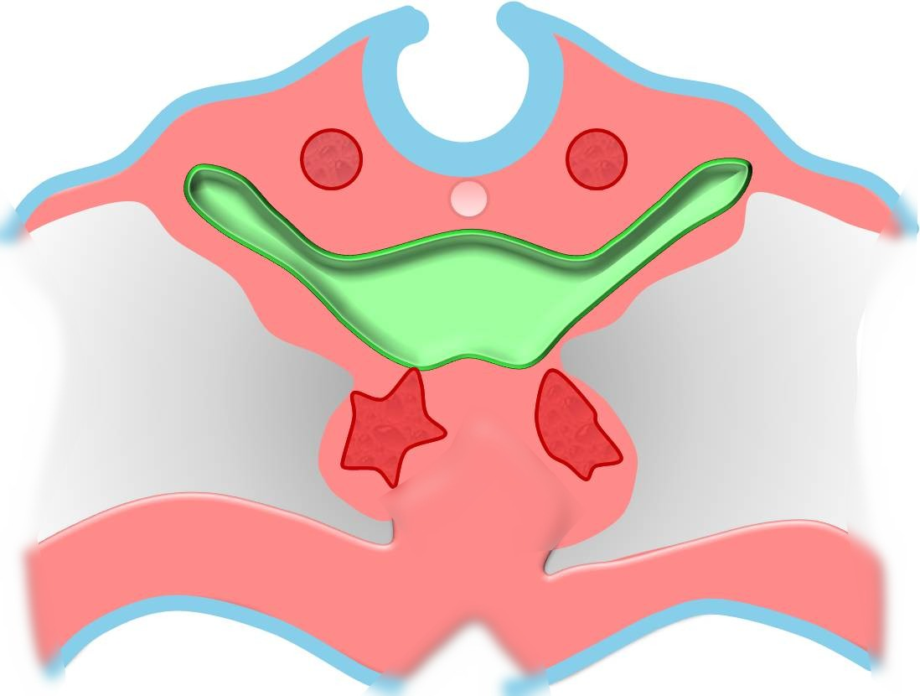

Slide 17
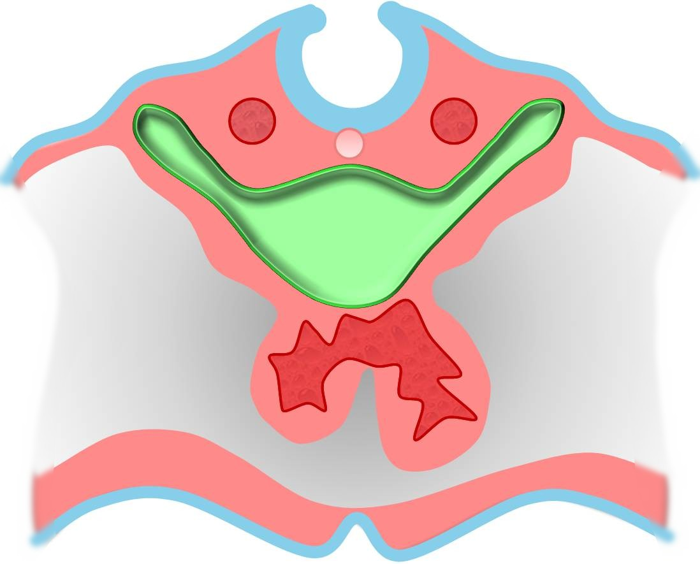

Slide 18
Dorsal aortae
Foregut
Pericardial coelom

Slide 19
Dorsal aortae
Foregut
Pericardial coelom
Fused heart tube

